Slide 1
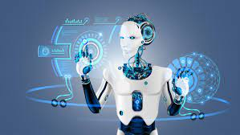
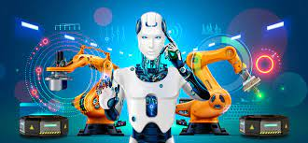
TERM PAPER REPORT
TOPIC-
ROBOTICS AND ARTIFICIAL INTELLIGENCE
PRESENTED BY-
SURVEPALLI SREEKRUTI(A2305220266-3CSE1)

Slide 2
ABSTRACT
Artificial intelligence is a modern science of engineering used to make machines intelligent.AI has been acting as a main driver of engineering technologies and will continue to act as an tech innovator for many decades to come.
‘ROBOT’ can be referred to both physical and virtual software agents.
Robotics is a sub branch of AI which is composed of electrical and mechanical engineering along with computer sciences.
AI and robotics are two different things in today’s date. Robotics include robots and their designing whereas AI is the software used in robotics.

Slide 3
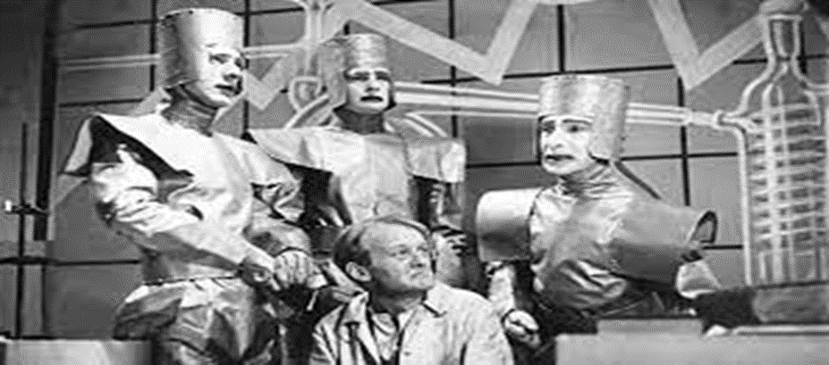
INTRODUCTION
The word ‘robot’ was coined by a Czech novelist Karel Capek in 1920.
Robots are basically referred to as a computer controlled device that combines the technology of digital computers with the technology of servo- control of articulated chains.
Since history robots are assumed to be creatures that mimic humans and do tasks in human like fashion.
Today, robotics is a rapid growing field. Various robots are being designed quite easily and fast as compared to the past, to serve various tasks.
The World Robotics 2020 Industrial robots report found 2.7 million robots already working across the world.

Slide 4
HISTORY
The first use of the word “ROBOTA” was in 1920 play RUR by Karel Kapek, a play writer. It actually meant a ‘worker’ or ‘servant’.
Its ironical that the word “ ROBOTICS” was also coined by a writer, Russian born- American science fiction writer Issac Asimov. He has used this is word for his short story “Runabout”. He had termed robots as cleaner and helpful race in the story.
he even derived “LAWS OF ROBOTICS”-
A robot should not injure a human by inaction or allow any human to come and harm them
A robot must follow the orders given to them by humans except to orders that would contradict with the first law.
A robot must protect its own existence as long as the protection does not contradict with the previous two laws.

Slide 5
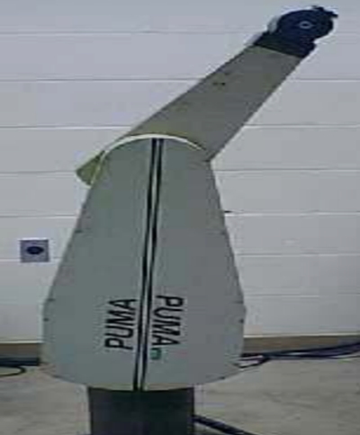
HISTORY
Finally in 1962, Joseph Engleberger and George Deveo built the first industrial robot, the PUMA(programmable universal manipulator arm).
In 1958, at Stanford Research Institute, Charles Rosen led a research team in developing a robot “ Shakey”. It was designed for specialized industrial applications. It could move around, observe the scene with his eyes, and to a certain degree respond to the surroundings.
The world of humanoid robots was introduced in 1970s by a Japanese university, Waseda university. They initiated ‘Wabot’ project in 1967 and by 1972 completed the WABOT-1.
‘Robonaut 2’ , the first humanoid robot was sent to space in 2011.
On October 25th 2017 the first female robot called ‘SOPHIA’
that was made in Saudi Arabia.

Slide 6
CHARACTERISTICS OF ROBOTS
“ Carrying out actions automatically and programmable by a computer”- are the key elements in robotics.
APPEARANCE- Robots have a physical body. They move with their mechanical parts.
BRAIN- Brain in robots is called ‘ON BOARD CONTROLLING UNIT’. They receive the information and they command the actions as output.
SENSORS-The use of sensors in robots is to obtain info from the outside and send it to brain. Sensors are what enable the robots to carry out complex tasks.
ACTUATORS-Actuators is the tool that enables robots to move. Their brain tells actuators when and how to respond or move.
PROGRAM-Robots are living+ non living species who works or responds to only those instructions that are installed in them. These programs tell the robot how to use sensors and data to make decisions.

Slide 7
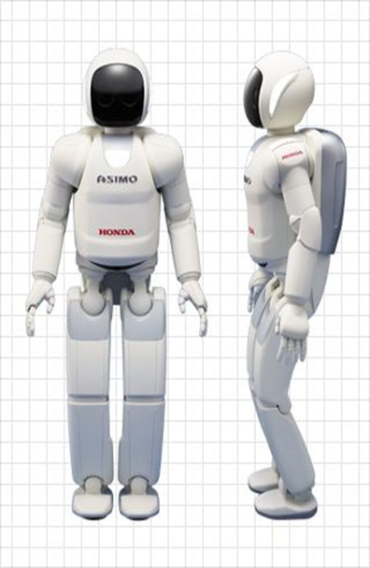
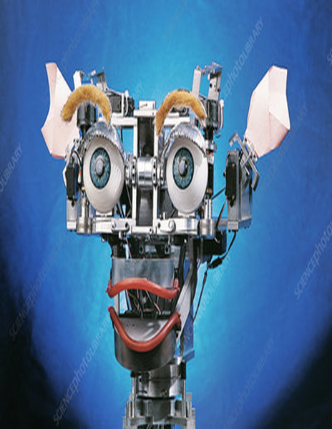
CHARACTERISTICS OF ROBOTS
BEHAVIOUR- Robot’s behaviour is decided by the program installed in them.
INTELLIGENCE-Innovations in the realms of computation and data mining enable the development of AI systems that reflect human intelligence.Eg-”KISMET” robot
POWER- Robots being an advanced electronic device, also needs energy source. Generators, batteries and fuel cells give power that is locally stored but also temporary.

Slide 8
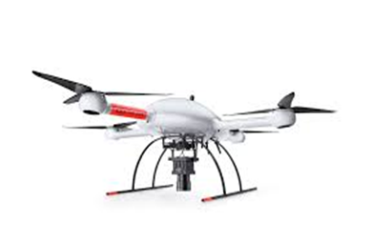
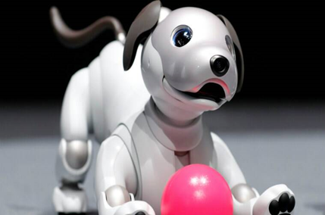
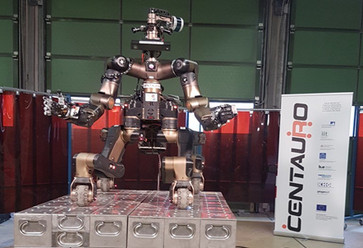
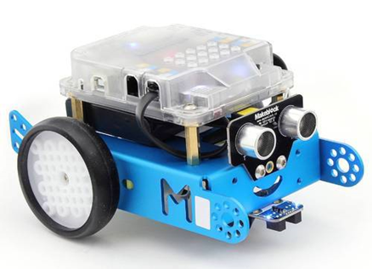
TYPES OF ROBOTS
Each robot has its own features, and as a whole, robots vary hugely in size, shape and capabilities. Let ’s see some types-
AEROSPACE- Consists of all sorts of flying robots. Eg- The smart bird ‘seagull’, ‘Raven’ drone.
CONSUMER- Made for the use of public. Eg- robot dog ‘Aibo’, ‘Roomba’ vaccum.
DISASTER They assist rescue efforts by searching, mapping, providing medical treatment etc. Eg- ‘Centauro’ robot.
EDUCATION-Includes hands on programmable sets from legos, 3D printers.Eg- mbots, robo wunderkids.

Slide 9
TYPES OF ROBOTS
ENTERTAINMENT- These robots are designed to evoke an emotional response and make us laugh or feel surprise or in awe. Eg- Honda ‘Asimov’, Dynamics robot dog ‘Spot’, ‘Pepper’ robot.
HUMANOIDS-A human robot with its body shape to resemble the humans.Eg- ‘Sophia’, robot ‘Shalu’.
INDUSTRIAL-An industrial robot is a robot system used for manufacturing. Eg- articulated robots, Cartesian robots, SCARA etc. Lets see some industrial robots-
ARTICULATED ROBOTS- It is a robot with rotatory joints.
CARTESIAN ROBOTS- They are robots whose three principal axis of control are linear and at right angles with eachother.
DELTA ROBOTS- They consists of parallel joint linkages.Used for pick and drop or product transfer apllications.

Slide 10
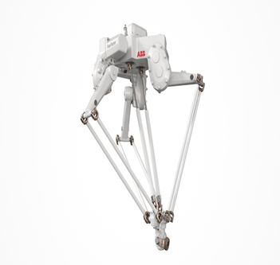
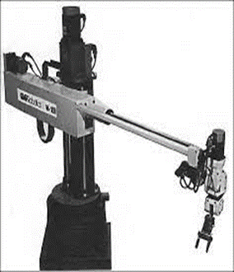
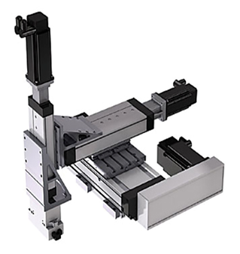
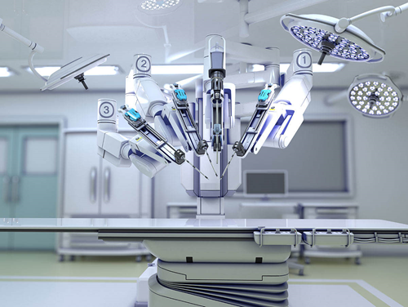
TYPES OF ROBOTS
4. SCARA- Stands for ‘Selective compliance assembly robot arm or Selective compliance articulated robot arm. The arm is totally rigid in the Z direction but titled in X-Y direction
5. POLAR ROBOTS- They have twisting joint connecting the arms with the base and a combination of 2 rotatory joints and one linear joint connecting the links.
6. CYLINDRICAL ROBOTS- These have a cylindrical workspace with a pivoting shaft and extendable arm which moves vertically.
MEDICAL ROBOTS- Medical and health care robots include systems such as the ‘DA VINCI SURGICAL ROBOT’ and bionic prostheses as well as robotics exoskeletons. Eg- Watson.

Slide 11
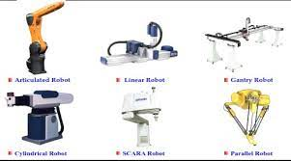
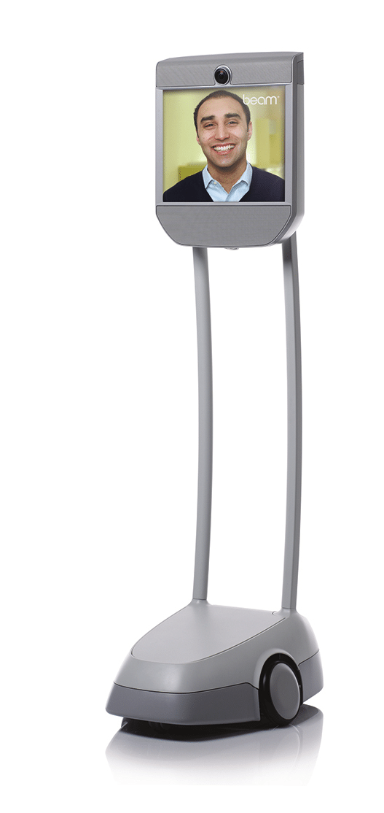
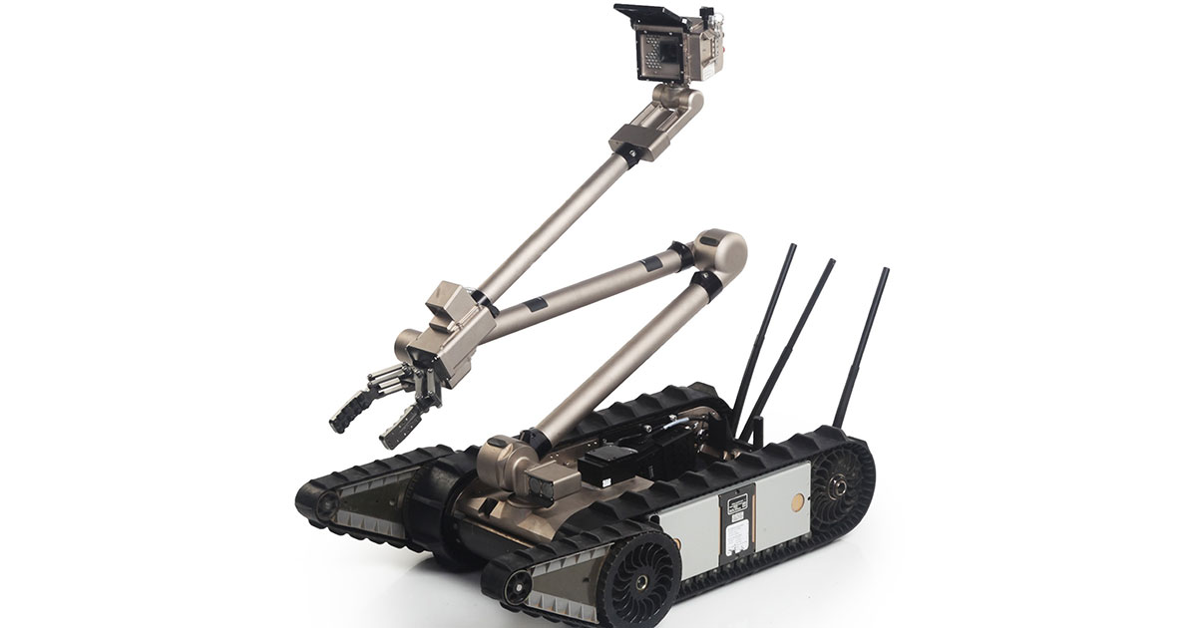
TYPES OF ROBOTS
MILITARY AND SECURITY- Military robots include ground systems like ‘Packbot’, used to scout for improvised explosive devices, and ‘Bigdog’, designed to assist troops in carrying heavy gear. Security robots include autonomous mobile systems such as ‘Cobalt’.
TELEPRESENCE- Telepresence robots allow you to be present at a place without actually being there. U log in the robot via internet and drive it around talking with people.
UNDERWATER- The favourite place for these robots is in the water, They consists of deep sea submersibles like ‘ Aquanaut’ driving humanoids like ‘Ocean One’ and bio inspired systems like the ‘ACM-R5H’ snakebot.

Slide 12
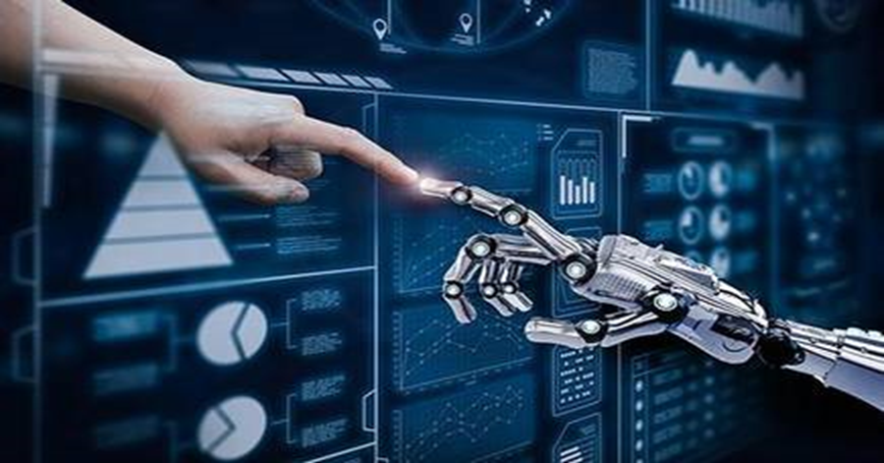
ADVANTAGES OF ROBOTICS
They increase production- They are designed for a job, and they don’t stop unless they breakdown or you turn them off.
They are more accurate than humans.
They make fewer mistakes
They are more reliable than humans.
They work 24/7.
They save time
They are versatile- We can design a robot for almost any task.
They are automatic- They can perform the assigned tasks without human intervention.
They can be used for any work- From helping in factories till constructing absolutely anything they can be used without hesitation.

Slide 13
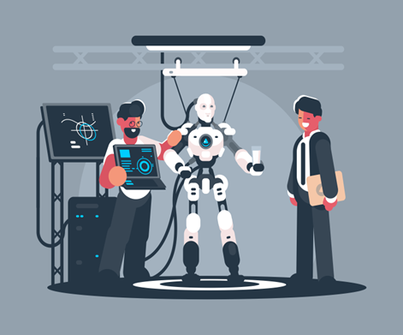
DISADVANTAGES OF ROBOTICS
They need constant power- Robots need oodles of electricity to run
They are restricted to their programming- Robots cant think for themselves. They rely on humans to program them for performing tasks.
They are expensive to install and run- Robots are high tech, top in the line and needed for a specific task, so they are not cheap to buy.
They pose potential physical danger from malfunctions- The last thing you want is a malfunction to cause the robot to do something dangerous.
They might create human beings over reliant- As robots become more widely available, used, and accepted in the society, we will become more relaint on them than on ourselves.
They may create employment problems in any field.
They might take over the world.

Slide 14
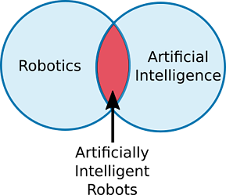
ROBOTICS AND AI
Robotics is a sub branch of AI which comprises of electrical and mechanical engineering along with computer sciences for construction, designing and application of robots.
The first thing we all need to understand is that robotics and AI are not the same things.
ROBOTICS-
Branch of technology that deals with robots.
Robots are program based machines that are usually able to
carry out a series of actions autonomously, or semi autonomously.
Eg- basic combat etc
ARTIFICIAL INTELLIGENCE-
AI is a branch of computer sciences.
It involves tasks by developing computer programs
Eg- Alpha go etc

Slide 15
ROBOTICS AND AI
ARTIFICIALLY INTELLIGENT ROBOTS-
They come in the category of AI controlled robots.
AI algorithms are necessary when you want to allow robots to perform complex tasks.
Eg- 1. A self driving car might use a combination of AI algorithms to detect and avoid potential hazards on the road.
2. A drone might use autonomous navigation to return home when its battery is low.
Robots are autonomous or semi autonomous machines, meaning they can act independently of external commands. Whereas, AI is software that learns and self improves.
This is why robotics have a wide future. We can use AI and machine learning together with robotics to make more advanced robots which would be more handy, easy and multifunctional.

Slide 16
ROBOTICS AND AI
AI PROGRAMS | ROBOTICS
1. Usually operate in computer based worlds. | 1. They operate in real and physical world
2. AI is the bridge between human intelligence and machine learning. | 2. Robotics is the sub branch of AI that uses it to improve its functions
3.Its human intelligence that compliments our mind to enhance its ability for performing tasks and self improvisation. | 3.They are autonomous and semi autonomous that use computer systems for control or information processing.
4. Applications that use AI are Netflix, Google’s Deepmind, Apple’s Siri, Spotify, and various online games etc. | 4. Common applications include personal assistance, scientific research, entertainment, automotive manufacturing etc.

Slide 17
WORLD OF ROBOTICS
Chinese is the leader in the robotics sales worldwide with share of about 40% according to the International Federation Of Robotics.
South Korea, Japan, U.S are in second, third and fourth position respectively.
Indian IT and the Indian generic drugs industry are the two areas where Indian companies have taken a march ahead.
‘Grey Orange’ a company founded by a bunch of Indian techies in 2011 is India’s biggest robotic technology company
Other Indian start up companies in robotics are Asimov Robotics, I2U2 robot and Sastra Robotics India etc.

Slide 18
ROBOTICS IN INDIA
A study released by industry association ASSOCHAM states that ‘ Robotics are a settled necessity for taking Indian industry globally competitive and the making country attractive for outside entrepreneurs for the ‘MAKE IN INDIA’ drive.’
IMPEDIMENTS-
Lack of hardware ecosystem- Results in imports of most of the components overcoming challenges in dual use certifications, high import duties, custom amongst other permission driven environments.
Financial incentives
Critical human resources- Lack of quality human resources with necessary skills and expertise to work with advanced manufacturing technologies negatively impacts the ability to undertake cutting edge R&D in India.
Mindset shift required- this industry faces lot of political and back mindset hurdles.

Slide 19
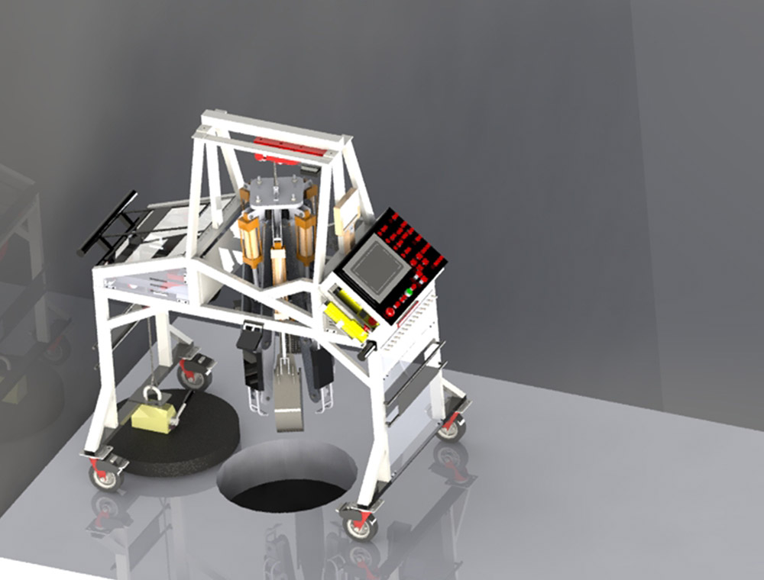
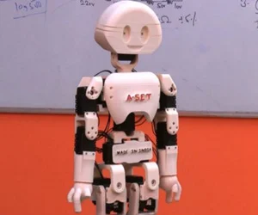
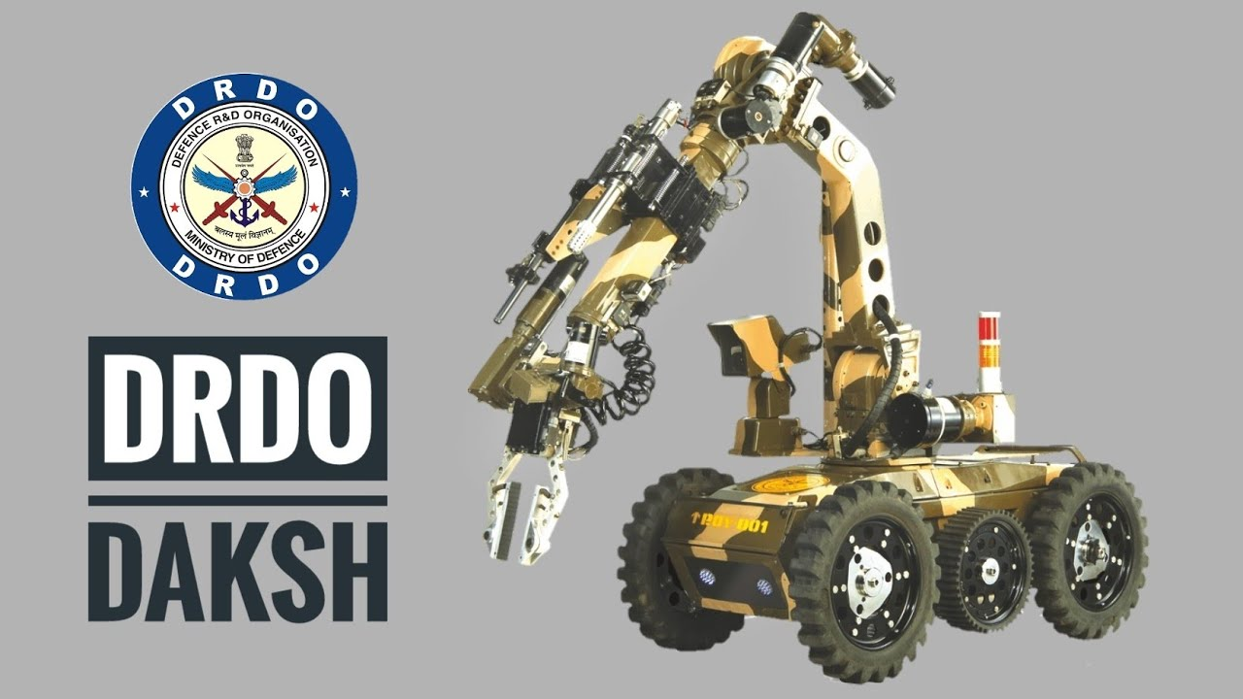
ROBOTS IN INDIA
Thiruvanthapuram- based started up ‘Genrobotics’ joined hands with Kerela gov.t to deploy a spider- shaped robot named “BANDICOOT” to clean sewers and manholes in the city
Banglore- based SME Suparna Plastics Ltd. which makes plastic ball valves is using SCARA robots .
Ahemdabad- based Apex hospital used Corpath technology of US- based Cornidus vascular Robotics.
‘Manav’, India’s first 3D-printed humanoid robot.
DRDO’s ‘Daksh’- This made-in-India robot is primarily designed to detect and recover improvised Explosive Devices.

Slide 20
BEST ROBOT COMPANIES IN WORLD
MIDEA GROUP- This group develops over 800 robots in production.
HEADQUARTERS- Foshan, China
DENSO GROUP- It builds industrial robots and programmable logic controllers used in manufacturing factory automation.
HEADQUARTERS- Kariya, Japan
SONY- It designed and developed a robotic pet called AIBO. This dog has the ability to communicate with humans as a normal pet.
HEADQUARTERS- Tokyo, Japan
SIEMENS AG- It is a global major player focussing on the areas of power generation, smart building infrastructure and distributed energy systems.
HEADQUARTERS- Munich, Germany
HONDA- Robotics developed the most advanced humanoid robot, ASIMO.
HEADQUARTERS-Tokyo, Japan

Slide 21
CONCLUSION
Robots are being used everywhere: in factories, homes, hospitals, and even in outerspace. Much research and development is being invested in developing robots.
Soon we are going to see robots almost everywhere. Caterpillar company plans to develop remote controlled machines and are expecting to develop heavy robots by end of 2021.
Today, we have experts in AI, ethics and morals to help provide sensible guidelines for the creation and use of robots.
Disruptive innovation in this Third Industrial Revolution- With the ability of computers to reduce communication time, complete tasks and transform an ever- evolving number of data input into systems of pure information that can be reorganized into vast interactive networks that function making to complex ecosystems- will be equally historic and important.

